Slide 1
Lumino
CMPE 272
Project Group 30
Aakash Alurkar
Aniket Deshpande
Rajas Tulpule
Sharwari Phadnis

Slide 2
What is Li-fi?

Slide 3
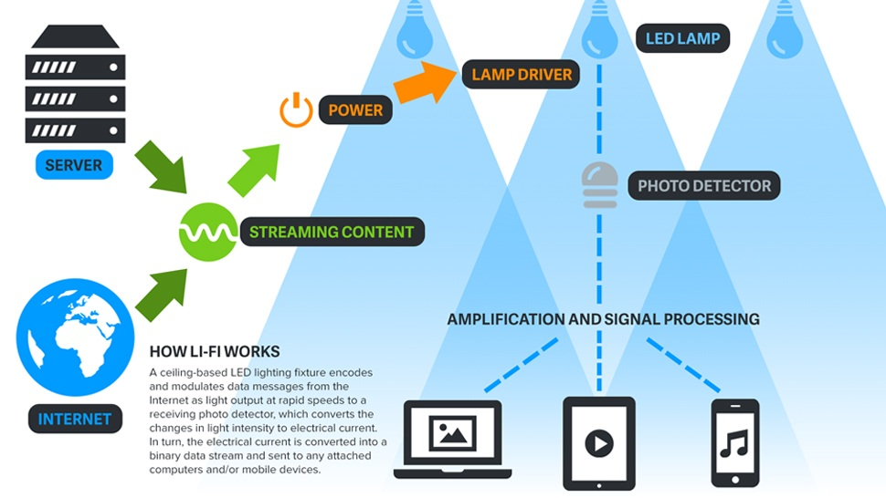
How does Li-FI work?

Slide 4
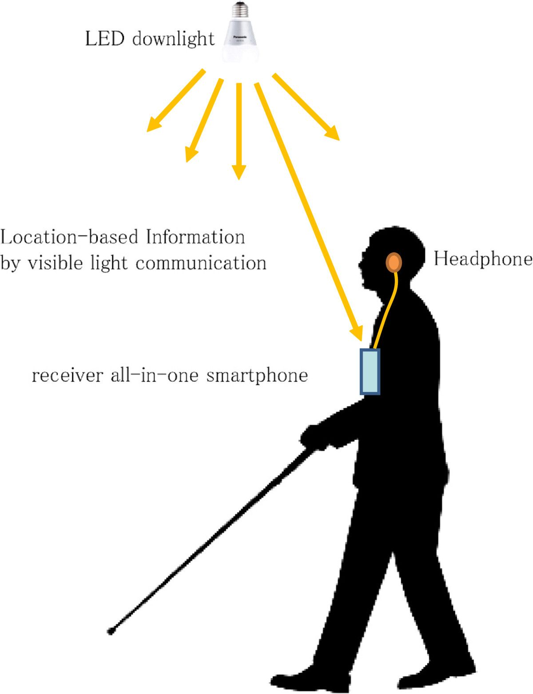
Indoor navigation system using li-fi for impaired

Slide 5
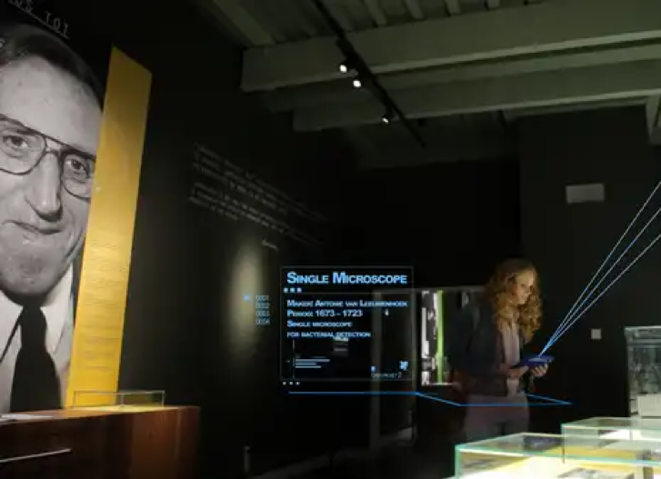
Museum enhanced experience with Li-fi

Slide 6

References
http://www.digital5sblog.com/internet-with-the-speed-of-light-lifi-technology/
https://physicsworld.com/wp-content/uploads/2018/02/PW_2017_12_15_LiFi.jpg
https://www.dailydot.com/wp-content/uploads/2018/03/lifi-2048x1024.jpg

Slide 7

Thank you

